Slide 1
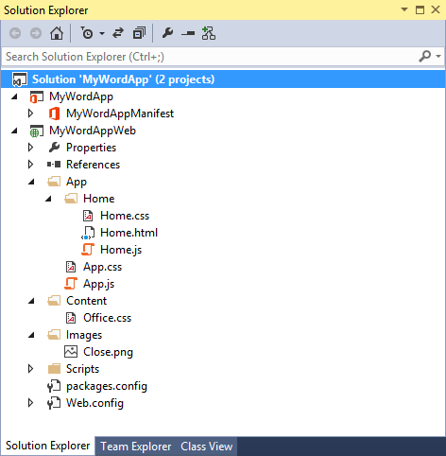
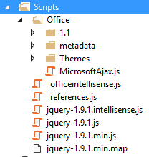
App for Office Project Structure
App for Office solution has two projects
Top project contains app manifest
Bottom project for remote web
Remote Web Project is ASP.NET Website
Contains HTML, CSS and JavaScript source files
Integration with jQuery library already included
Notes:
The slide shows the initial structure of a task pane app created with the Visual Studio 2012.

Slide 2
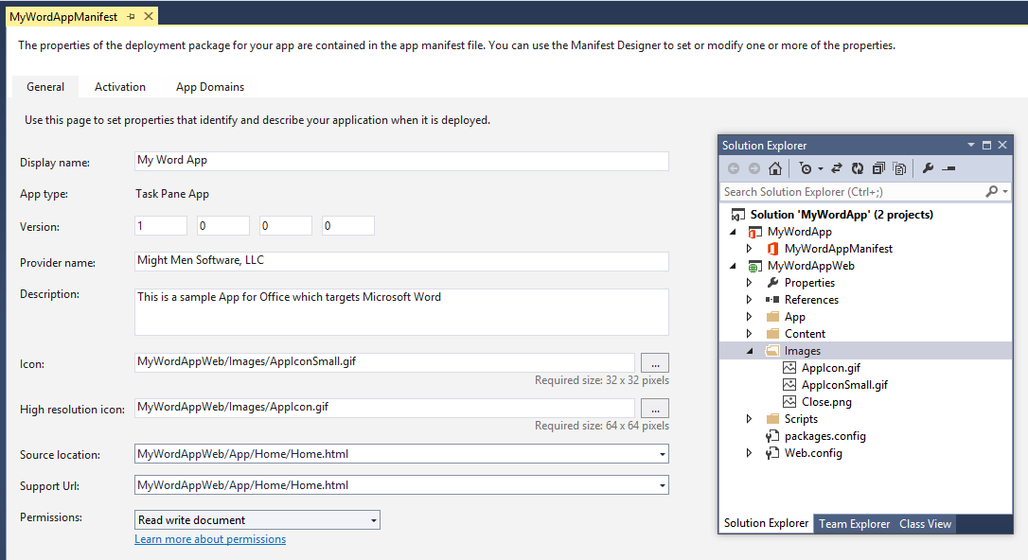
App Manifest Designer
Notes:
This slide shows the Visual Studio designer for an app manifest in a task pane app. It will look different for other types of Apps for Office.

Slide 3
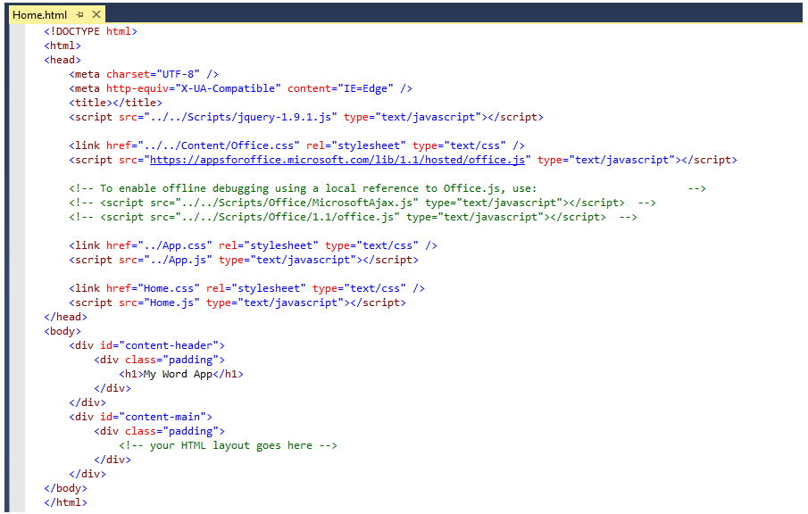
Create the HTML for a Web Page
Notes:
Each app has a source location which points to a entry point Web page somewhere on the Internet. Here is an example of a simple Web page that is used to load a task pane app. Note that this page must link to any required CSS files and JavaScript that will be adding styles or behavior behind the app. Visual Studio automatically adds the links for jQuery and ASP.NET AJAX. Also note that the page adds HTML elements which are often created with ids and/or classes.

Slide 4
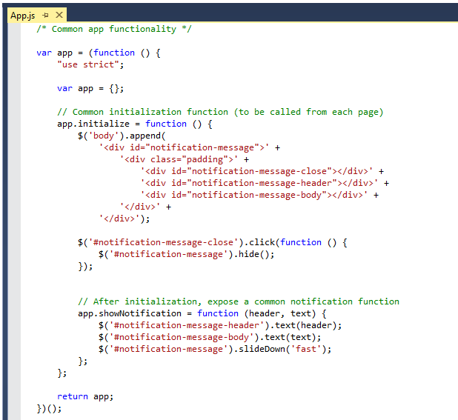
Code Added by Visual Studio
Notes:
JavaScript is the language that is used to add executable code and behavior to a App for Office. The JavaScript you write for an app will typically take advantage of the various JavaScript APIs supplied for Office.js and other JavaScript library files for specific Office applications such as Word, Excel and Outlook. In addition to the Office JavaScript APIs, the JavaScript code you write for an app for Office can also take advantage of the ASP.NET AJAX library as well as jQuery.
The Office JavaScript API provide a top-level named Office which provides an initialize function. By overriding this function as shown in the code above, you can write code that will automatically execute as the end of the initialization process when an app is started. A common approach is to register a jQuery document ready event handler inside this function.

Slide 5
Navigation and Links
DOs
Provide hyperlinks to open in browser
Design app to fit on one host page
Use IFrame with navigation bar if absolutely necessary
Consider ways to provide messages to users
DON’Ts
Expect hyperlinks to different domains to open in app window (blocked).
Send users to trapped pages via poor navigation trails
Use alerts
Notes:
This slides discusses what to use and what to avoid when designing an app.
Do provide hyperlinks within an to open Web pages in a new browser window. This makes it easier to design an app that fits cleanly on a single host page. Within the host page you can also use an IFrame to host content and provide a navigation bar if needed to change the contents of the IFrame using JavaScript. Also consider how your app will provide informational messages to the user. Typically this is done by adding a HTML element such as a div to the host page and dynamically writing text inside using JavaScript.
Here is a list of design issues to avoid. When creating hyperlinks, do not use <a> tags without a target attribute to open the link in a new window browser. You will find that such links are blocked by the Office UI if they attempt to take the user to a different domain. Also avoid links which navigate the user to pages which do not allow them to return to the start page as there is nothing similar to the back button inside the browser. Also, avoid interaction with the user using the poor man's technique of using the JavaScript alert function which has more restrictions inside an app than it does when used inside a browser.

Slide 6
Context Menus and Settings Controls
Full control of what is inside the App for Office
Developer can override the right-click Context Menu
No Control to customize the App container menus.
Developer cannot customize Task Pane or Content/Chart object menu
Ability to save settings to “property bag”
Property bag values saved with the app in the document
Notes:
If you want an app to provide custom menus to the user, you should understand that you have control only of the users interface inside the app but not any UI elements outside. You can override the app context menu that appears at the upper right-hand corner of an app. However, when creating an app you have no control over customizing any other menus within Office apps.
Also remember that you have the ability to save custom properties as name values pairs using the settings API. These names value pairs are saved within the current document with task pane apps and with content apps. With mail apps these property values are saved within Exchange along with the host message or appointment.

Slide 7
demo
Creating an App for Office Targeting Microsoft Word

